Slide 1
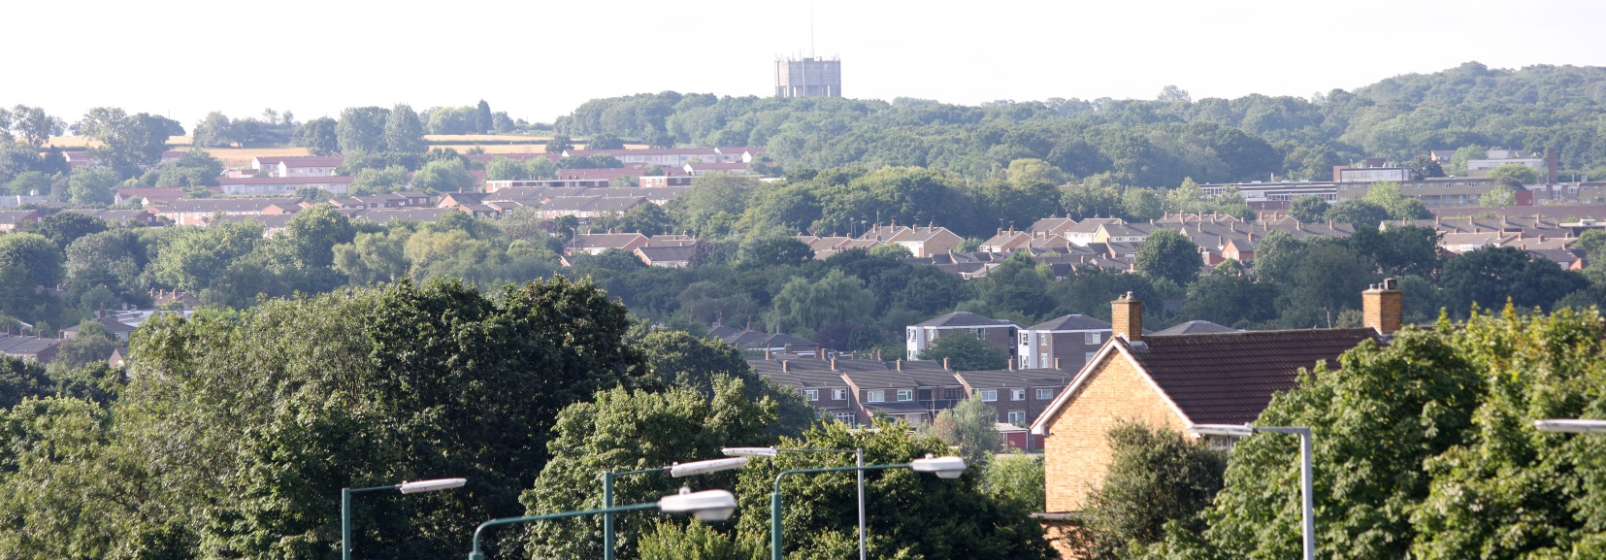
Heading in 44pt Arial Sub heading can go along here in 18pt, with date of presentation.

Slide 2
Heading Arial 36pt
Text Arial at least 19pt.
No more than 5 bullets per page.
Keep jargon out of your text – use plain English.
You can change the style of bullet point to suit your presentation.
Don’t let text or images clash with the logo or web address at the bottom of the slide. Keep some white space between them.

Slide 3
Heading Arial 36pt
Sub heading could go here:
You can change the colour of the boxes on the first and last slides.
Choose images on the front and back slides and throughout that are relevant to your presentation.
Right click over an image and select ‘change image’ from the drop- down menu.
If you require a ‘black text’ copy of the logo please speak to Communications.

Slide 4
Heading Arial 36pt
“You could break your presentation up with strong images and quotes relating to your subject”

Slide 5
Heading Arial 36pt
Text placed here. Try to use nothing smaller than 19pt type size, unless for a note at the bottom of the slide.
Choose a colour style for your charts that will compliment your presentation, or use style series 2.

Slide 6
Any questions?

